Slide 1
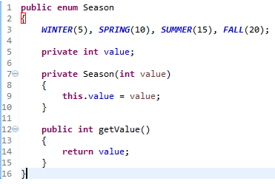
Java Enum
Enum can have fields, constructors and methods.

